Slide 1
WEEK 2 LESSON 1
ELEMENTAL SPECTRA

Slide 2
Flame tests and atomic absorption spectroscopy (AAS) are analytical techniques that can be used to identify elements; these methods rely on electron transfer between atomic energy levels and are shown by line spectra
In an atom, electrons are found in a specific arrangement around the nucleus. When all of the electrons are in their lowest possible energy levels, the atom is said to be in the ground state.

Slide 3
MOVEMENT OF ELECTRONS
When an atom absorbs energy, such as heat, the electrons in the energy levels around the nucleus gain this extra energy and can move up to a higher energy level. So the amount of energy they absorb can only be equal to the difference between one energy level and another.

Slide 4
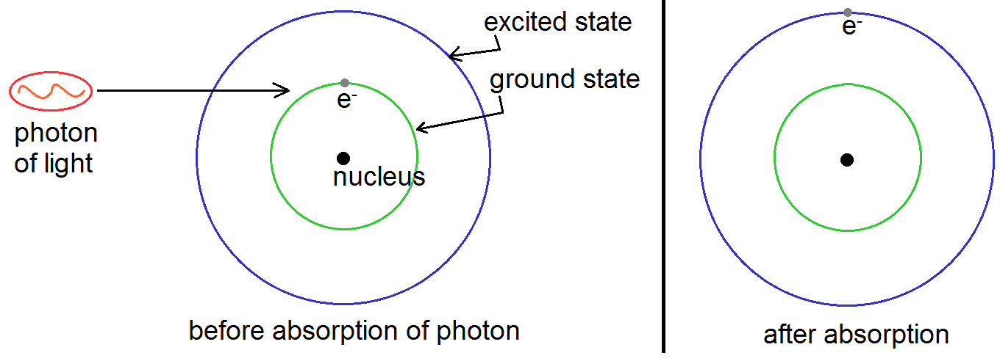
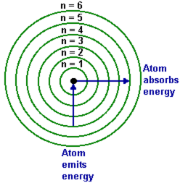

Slide 5
An atom with electrons in upper energy levels is said to be in an excited state.
Electrons in the excited, higher energy levels are unstable. After a very short time, less than one-millionth of a second, the electrons move down to their original levels. When they do, they release their energy that they previously absorbed.
This energy is emitted as light. Energy is related to wavelength of light produced. As electrons can move between a number of different levels, different wavelengths of light are emitted from a sample.

Slide 6
As all magnesium atoms have the same energy levels, the light emitted by all magnesium atoms will have a consistent set of wavelengths.
The light emitted by oxygen will have different wavelengths from the light emited by the magnesium.

Slide 7
EMISSION SPECTROSCOPY
The energy absorbed or released in the electron transitions of a given element are unique for that element and hence its resulting line spectrum is also unique. This is why an element’s line spectrum (emission spectrum), is like an atomic fingerprint that can be used to identify it.
When a sample of an element is heated it will absorb energy. Its electrons will move to higher energy level and fall back down to the ground state, emitting light which can be analysed. The process of analysing light is called spectroscopy.

Slide 8
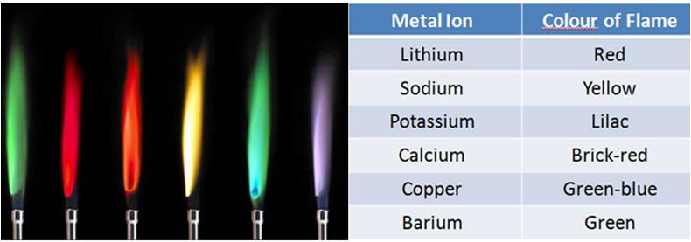
Flame test: A thoroughly cleaned platinum wire loop is used to place a small sample of the unknown, usually a salt into a hot, almost colourless Bunsen flame. The heat of the flame excites electrons in the vaporised metal ions of the salt. When the excited electrons return to their ground state they emit light of specific wavelengths, producing characteristic colours. From the flame colour the metal element present in the salt can be identified.

Slide 9
A spectroscope is a device used to take the light emitted from an element and separate it into its component wavelengths to produce a line emission spectrum.
Each element has a unique set of levels, so when the electron move between them, it will involve absorption and emission of different amounts of energy. This means that every element will emit light of a different set of wavelengths from every other element.

Slide 10
Because every atom of element has the same set of energy levels, the pattern produced for an element will always be the same. This is a way of identifying elements. An unknown element is heated and the light emits is analysed and compared with known spectra.
Complete question: 10 from page: 22 of Essential Chem Unit 1 &2

